Slide 1
PowerPoint 3:
Three Levels of Government

Slide 2
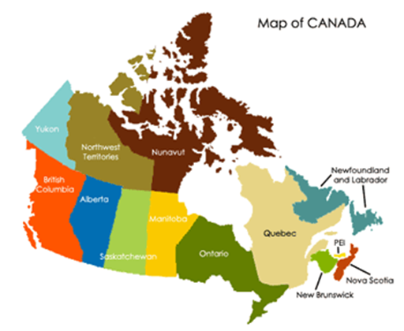
Three Levels of Government
Canada is a very large country of many people with different needs and interests.
To properly address these needs and interests, the Canadian government is structured into a three level system: federal, provincial/territorial and municipal/local.
Each government has its own level of elected representatives and appointed officials, as well as specific matters they are responsible for.

Slide 3
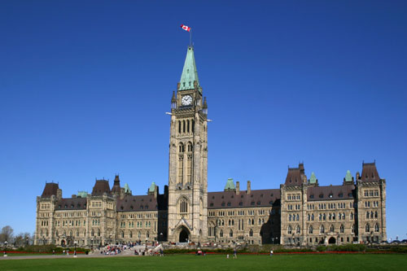
Federal
The elected representative at the federal level is called a Member of Parliament (MP).
Canadians will elect 338 MPs in the current election.
MPs debate and pass laws in the House of Commons in Ottawa.
The leader of the government is called the prime minister.
The Queen is represented by the governor general.

Slide 4
Provincial/Territorial
The elected representatives are called Members of the Legislative Assembly (MLAs), Members of Provincial Parliament (MPPs), Members of the National Assembly (MNAs) or Members of the House of Assembly (MHAs), depending on the province or territory.
Elected representatives debate and pass laws at the provincial or territorial legislature.
The leader of the government is called the premier.
The Queen is represented by a lieutenant governor in Canada’s ten provinces and by a territorial commissioner in the three territories.

Slide 5
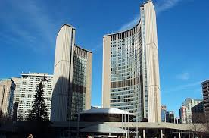
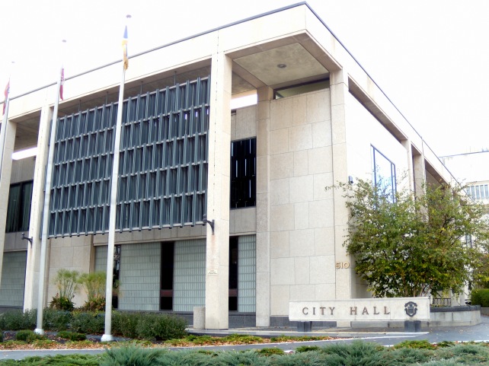
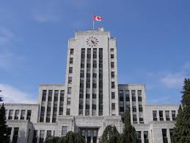
Municipal/Local
The elected representative at the municipal level is called a councillor or alderman.
The head of the council is called a mayor, reeve or chairperson.
The size and structure of the council differs, depending on the population.

Slide 6
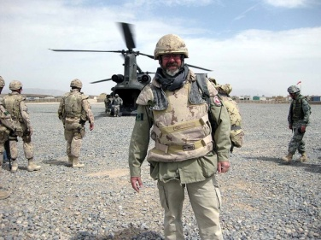
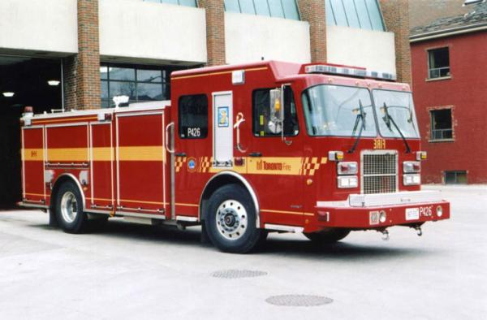
Division of Responsibilities
Federal: Justice, citizenship and immigration, national defence, currency, public safety, fisheries and oceans
Provincial/Territorial: Education, healthcare delivery, environment, energy
Municipal/Local: Road maintenance, water and sewer service, recreation and community facilities, libraries, police protection services

Slide 7
Final Thoughts
How does government affect your life?
Which level of government affects your life the most? Why?
Why is it important to know who your local elected representative is?

