Slide 1
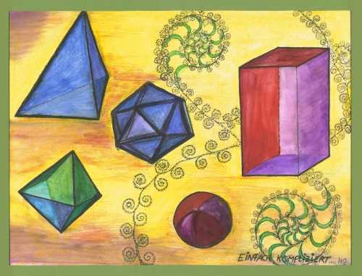
Transformations

Slide 2
LEARNING INTENTIONS:
1.) I can complete, recognize, and plot a translation.
2.) I can complete, recognize, and plot a rotation around a centre of axis.
3.) I can complete, recognize, and plot a reflection over a line of reflection.

Slide 3
To transform something is to change it. In geometry, there are specific ways to describe how a figure is changed. The transformations you will learn about include:
Translation
Rotation
Reflection
Dilation

Slide 4
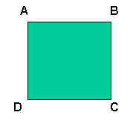
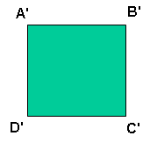
Renaming Transformations
It is common practice to name transformed shapes using the same letters with a“ ” symbol:
It is common practice to name shape
using capital letters:
prime

Slide 5
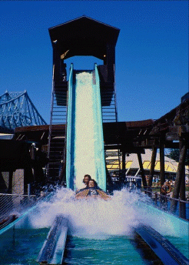
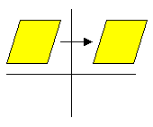
A “slides” an object a fixed distance in a given direction. The original object and its translation have the, and they .
Translations are
Translation
same shape and size
face in the same direction
SLIDES.

Slide 6
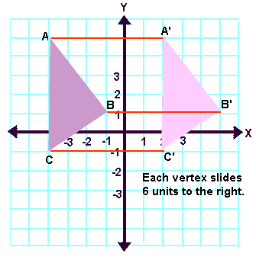
Let's examine some translations related to
The example shows how each vertex moves the same distance in the same direction.
coordinate geometry.

Slide 7
Write the Points
What are the coordinates for A, B, C?
What are the coordinates for A’, B’. C’?
How are they alike?
How are they different?
A (-4,5)
B (-1,1)
C (-4,-1)
A’ (2,5)
B’ (5,1)
C’ (2,-1)
They are similar triangles
Each vertex slides 6 units to the right

Slide 8
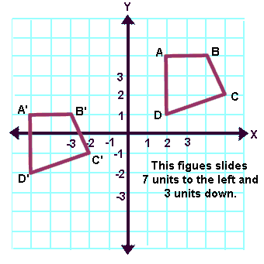
In this example, the "slide" moves the figure
and .
7 units to the left
3 units down
(or 3 units down and 7 units to the left.)

Slide 9
Write the points
What are the coordinates for A, B, C, D?
What are the coordinates for A’, B’, C’, D’?
How did the transformation change the points?
A (2, 4)
B (4, 4)
C (5, 2)
D (2, 1)
A’ (-5, 1)
B’ (-3, 1)
C’ (-2, -1)
D’ (-5, -2)
The figure slides 7 units to the left and 3 units down

Slide 10
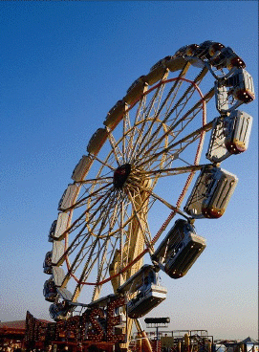
A is a transformation that turns a figure about a fixed point called the center of rotation. An object and its rotation are the , but the
rotation
same shape and size
figures may be turned in different directions

Slide 11
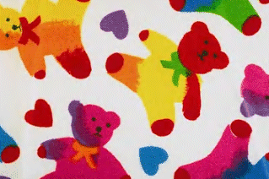
The concept of rotations can be seen in wallpaper designs, fabrics, and art work.
Rotations are
TURNS!!!

Slide 12
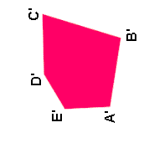
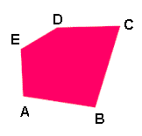
This rotation is 90 degrees counterclockwise.
Clockwise
Counterclockwise

Slide 13
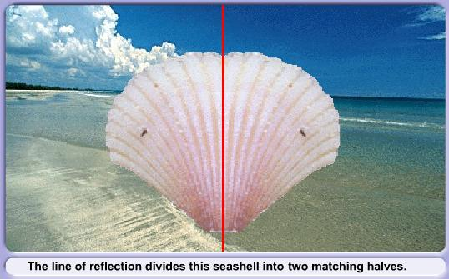
A can be seen in water, in a mirror, in glass, or in a shiny surface. An object and its reflection have the , but the . In a mirror, for example, right and left are switched.
reflection
same shape and size
figures face in opposite
directions

Slide 14
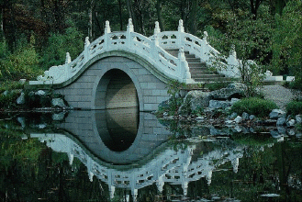
Line reflections are
FLIPS!!!

Slide 15
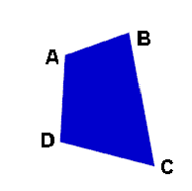
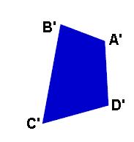
The line (where a mirror may be placed) is called the line of reflection. The distance from a point to the line of reflection is the same as the distance from the point's image to the line of reflection.
A reflection can be thought of as a "flipping" of an object over the line of reflection.
line of reflection
If you folded the two shapes together line of reflection the two shapes would overlap exactly!
line of
reflection

Slide 16
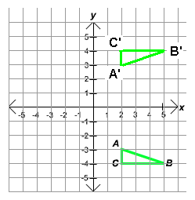
What happens to points in a Reflection?
Name the points of the original triangle.
Name the points of the reflected triangle.
What is the line of reflection?
How did the points change from the original to the reflection?
A (2,-3)
B (5,-4)
C (2,-4)
A’ (2,3)
B’ (5,4)
C’ (2,4)
x-axis
The sign of y switches

Slide 17
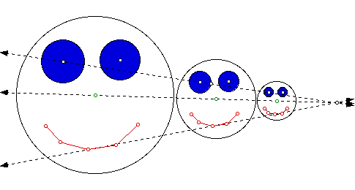
A dilation is a transformation that produces an image that is the same shape as the original, but is a different size.
A dilation used to create an image larger than the original is called an enlargement. A dilation used to create an image smaller than the original is called a reduction.
dilation
same shape
different size.
larger
enlargement
smaller
reduction

Slide 18
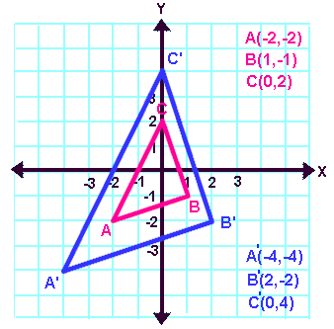
Dilations always involve a change in size.
Notice how EVERY coordinate of the original triangle has been multiplied by the scale factor (x2).

Slide 19
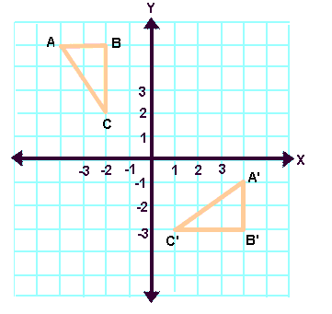
REVIEW: Answer each question………………………..
Does this picture show a translation, rotation, dilation, or reflection?
How do you know?
Rotation
Because the image is turned.

Slide 20
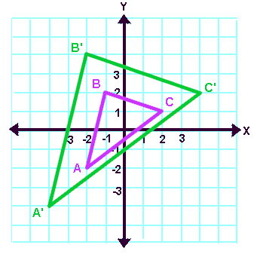
Does this picture show a translation, rotation, dilation, or reflection?
How do you know?
Dilation
Because the post- image got bigger.

Slide 21
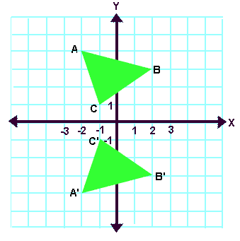
Does this picture show a translation, rotation, dilation, or reflection?
How do you know?
(Line) Reflection
Because the image flipped over.

Slide 22
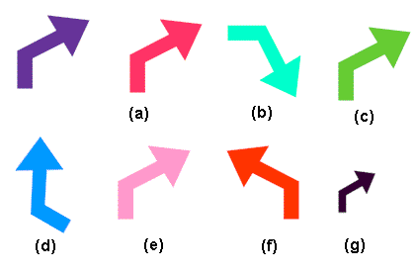
Which of the following lettered figures are translations of the shape of the purple arrow? Name ALL that apply.
Explain your thinking.
purple arrow
Letters a, c, and e are translations of the purple arrow.

Slide 23
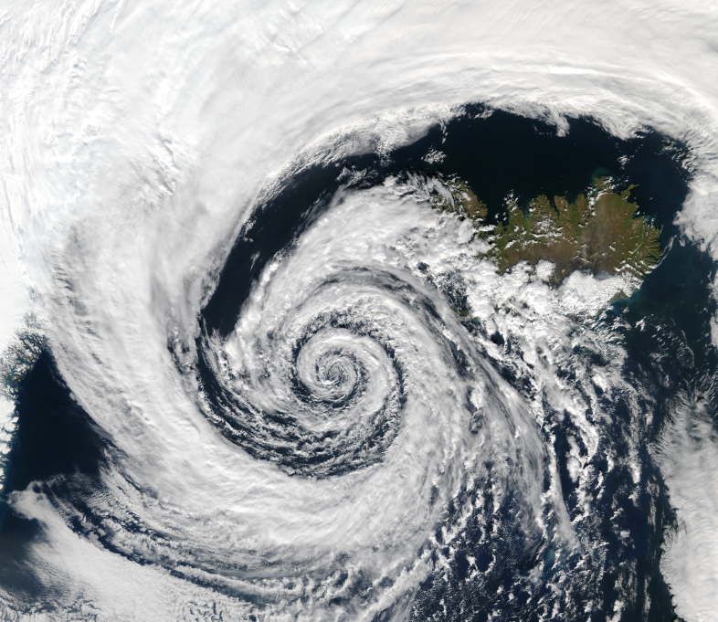
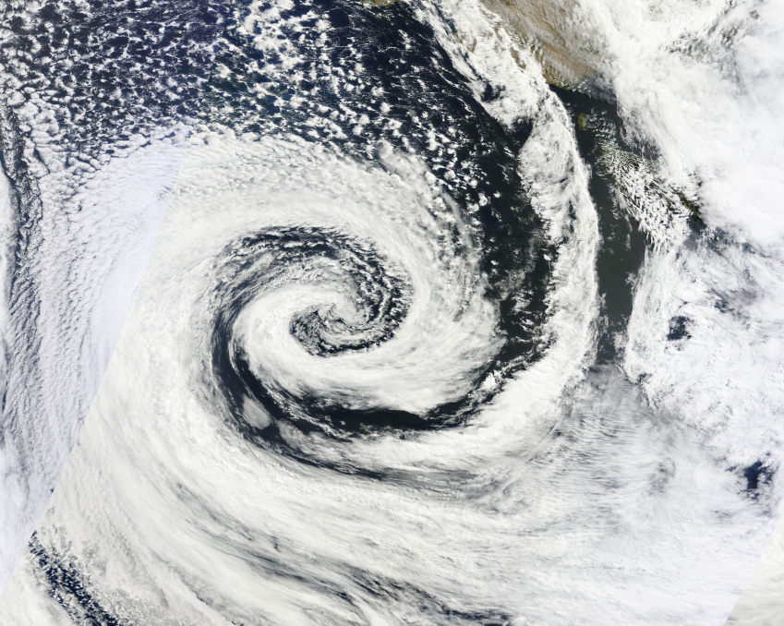
Has each picture been rotated in a clockwise or counter-clockwise direction?
Clockwise
Counter-Clockwise

Slide 24
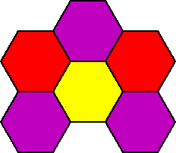
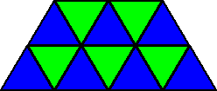
Basically, a tessellation is a way to tile a floor (that goes on forever) with shapes so that there is no overlapping and no gaps.
tessellation

Slide 25
Dutch graphic artist M. C. Escher (1898-1972) is known for his creative use of tessellations in his work. What transformations can you see in this picture?
The birds and fish have been translated here.

Slide 26
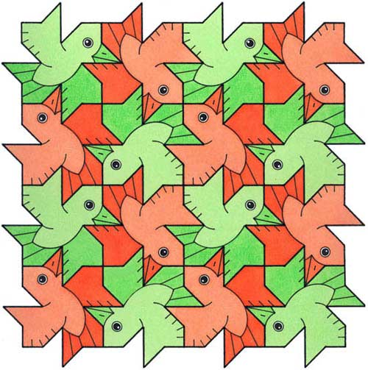
What transformations can you see in this Escher print?
Some birds have been translated and some have been rotated.

Slide 27
Can you name examples in real life of each transformation?
Translation
Rotation
Reflection
Dilation

