Slide 1
Earthquakes
By: Greg Heffley

Slide 2
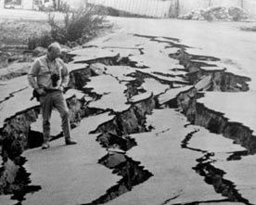
What are earthquakes?
Earthquakes are Earth’s way of releasing stress. This happens when two plates collide and break. Imagine this, when you hold a pencil horizontally and push hard on each side, it starts to bend and it soon breaks. As a result, when it breaks it releases stress.
1.http://0-scign.jpl.nasa.gov
2.www.manataka.org

Slide 3
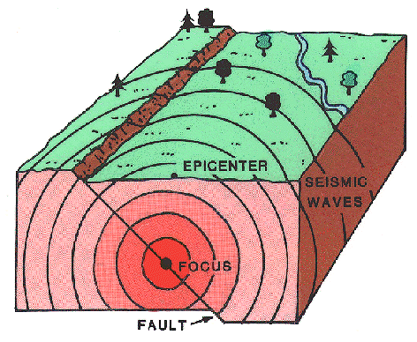
What Causes Earthquakes?
The shaking motion of an earthquake is the result of a sudden release of energy. Earthquakes are caused when stress builds up within rocks of the Earth's crust is released in a sudden jolt. Rocks crack and slip past each other causing the ground to vibrate.
1.http://www.em.gov.bc.ca
2.http://www.em.gov.bc.ca

Slide 4
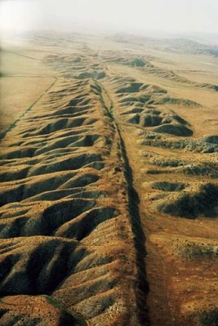
What are Faults?
A fault is a fracture between two blocks of rocks, it allows the blocks to move the same to each other. But it may happen very fast, in the shape of an earthquake or may happen very slowly. Faults may go up by a few millimeters to thousands of kilometers!
1,http://earhquake.usgs.gov
2. http://www.livesting.com/

Slide 5
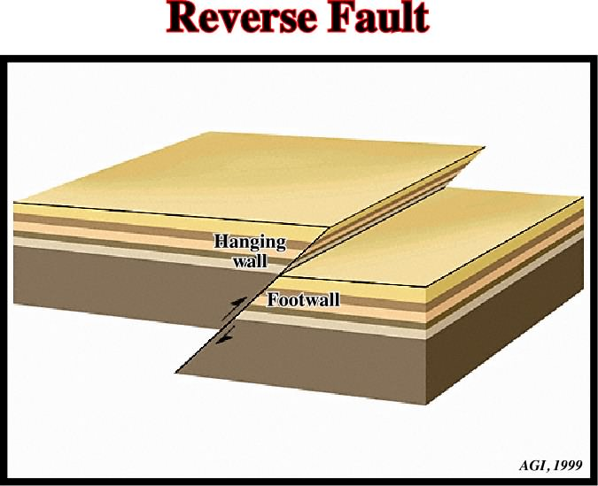
Reverse Fault
Reverse faults are exactly the opposite of normal faults. If the hanging wall rises the same to the footwall, you have a reverse fault. In the reverse fault a rock is above the fault and is forced up and the other rock gets forced up. Reverse faults also occur in areas undergoing squishing.
1.htto://www.pit.edu/
3. BC Science 7 Book
2.http://homepage.ufp/

Slide 6
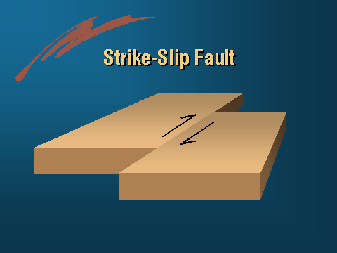
Strike Slip Faults
Strike slip faults is when the blocks of rock on either side of the fault slide horizontally. They are vertical (or nearly vertical.) All strike-slip faults are formed where two parts of the earth’s crust (plates) slide past each other.
1,.http://earthquake.usgs.gov
2.http://www.abag.ca.gov/

Slide 7
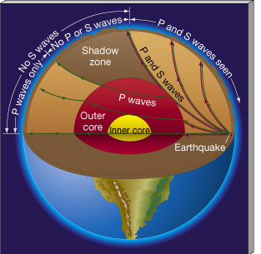
What are Seismic Waves?
Seismic waves are waves of energy that travel through the Earth. Seismic waves are studied byseismologists and geophysicists
1.http://en.wikipedia.org/wiki/Seismic_wave
2.http://astronomy.nju.edu.cn/

Slide 8
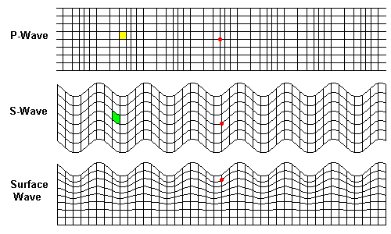
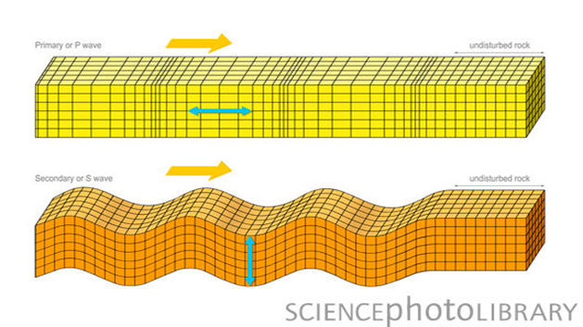
What Types of Seismic Waves are there?
There are four types of seismic waves, body waves, surface waves, P wave or primary wave, and the S wave or secondary wave.
1,http://en.wikipedia.org/wiki/Seismic_wave
2.http:physicsquest.homestead.com
3.http://www.sciencephoto.com

Slide 9
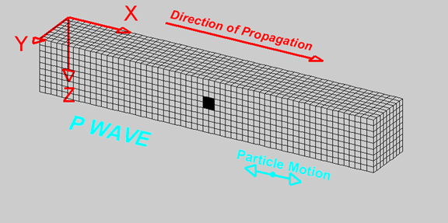
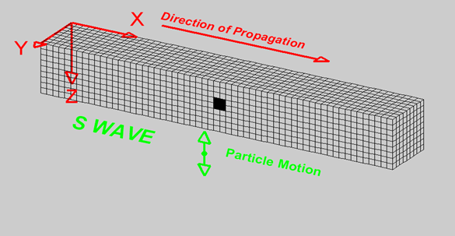
What’s the Difference Between the Types of Seismic Waves?
Surface waves travel only through the crust and are almost entirely responsible for the damage with earthquakes. However, P waves are the first type of body wave and is the fastest kind of seismic wave, it’s also known as primary wave. The S wave is the second wave you feel in an earthquake, but can only move through solid rock not liquid. A body wave is a seismic wave that moves through only the inside of the Earth.
1,http://www.geo.mtu.edu/UPSeis/waves
2.http://www.geo.mtu.edu/UPSeis/waves.html
3.http://earthquake.usgs.gov/l
- Surface Waves
4.http:upload.wikimedia.org/
- P Wave
5.http://www.geo.mtu.edu/
- S Wave
6.http://web.ics.purdue.edu
- Body Wave
7. http://www.sciencephoto.com

Slide 10
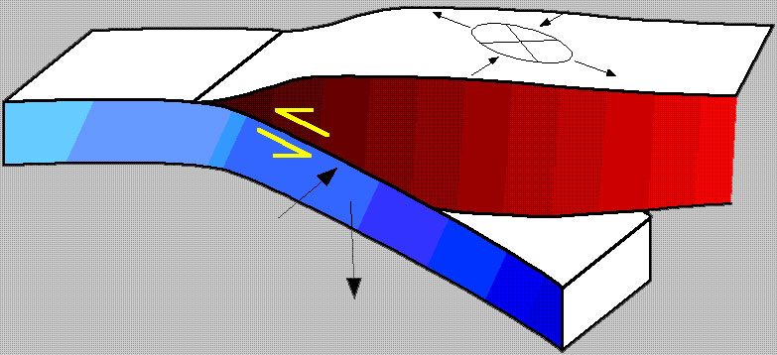
What Causes Seismic Waves?
Rock blocks suddenly move deep into the Earth in response to tectonic stress. Energy in the form of seismic waves moves outward through the rock from the point of where it came from.
1.http://www.cliffsnotes.com
2.http://walrus.wr.usgs.gov

Slide 11
What’s a Body Wave?
A body wave is a seismic wave that moves through the inside of the Earth, as opposed to surface waves that travel near the earth's surface. P and S waves are body waves. Each type of wave shakes the ground in different ways.
1.http://earthquake.usgs.gov/
2.http://www.sciencephoto.com

Slide 12
What’s a P wave?
The first kind of body wave is the P wave or primary wave. This is the fastest kind of seismic wave, and, the first to 'arrive' at a seismic station. The P wave can move through solid rock and fluids, like water or the liquid layers of the earth. It pushes and pulls the rock it moves through just like sound waves push and pull the air.
1.http://www.geo.mtu.edu/UPSeis/waves.htm
3. BC Science 7 Bookl
2.http://www.geo.mtu.edu/

Slide 13
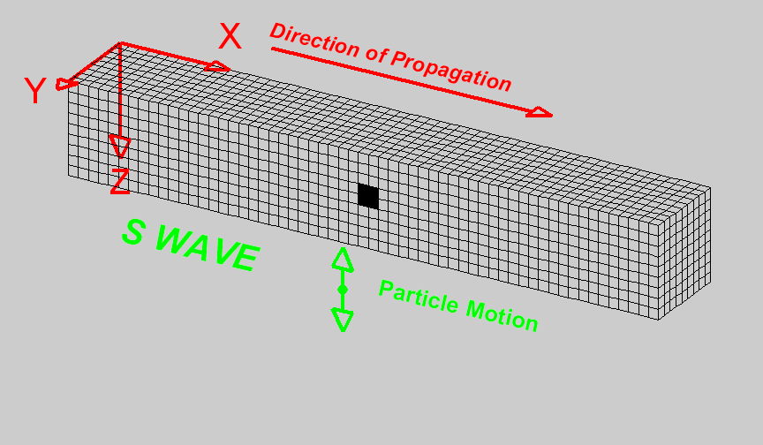
What’s a S wave?
The second type of body wave is the S wave or secondary wave, which is the second wave you feel in an earthquake. An S wave is slower than a P wave and can only move through solid rock, not through any liquid like water . It’s this type of S waves that led seismologists to conclude that the Earth's outer core is a liquid.
1,http://www.geo.mtu.edu/UPSeis/
3. BC Science 7 Book
2.http://web.ics.purdue.edu

Slide 14
What are Surface Waves?
Surface waves are the slowest of all the 3 waves but can break up buildings and roads. Also travelling only through the crust, surface waves are more rarer than body waves, and you can easily tell it on a seismogram as a result. Though they arrive after body waves, it is surface waves that are almost entirely responsible for the damage with earthquakes.
1.http://www.geo.mtu.edu/UPSeis/waves
3. BC Science 7 Book
2.http:upload.wikimedia.org/

Slide 15
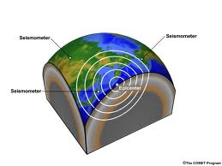
How Do You Locate An Earthquake?
Well, to figure out just where that earthquake happened, you need to look at your seismogram and you need to know what at least two other seismograms recorded for the same earthquake. You will also need a map of the world, a ruler, a pencil, and a compass for drawing circles on the map.
1.http://www.geo.mtu.edu/
2.http://t1.gstatic.com/

Slide 16
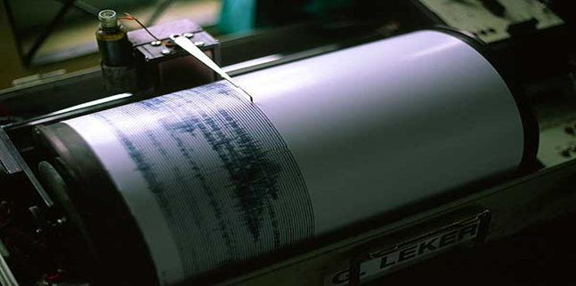
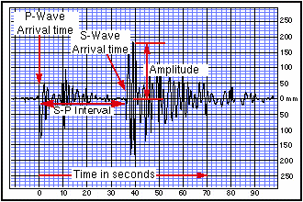
What Instruments Do you Use?
You would need to use a seismograph and a seismogram. Because seismographs measures earthquakes and seismograms measure seismic waves.
1.http://en.wikipedia.org/wiki/Seismometer
2/http://www.geo.mtu.edu/UPSeis/locating.html
-Seismograph
3.http://4.bp.blogspot.com/
- Seismogram
4.http://www.sciencecourseware.org

Slide 17
What is a Seismograph
Now I will be telling you about the vibrations produced by earthquakes are found, recorded, and measured by instruments called seismographs. The newest type of seismographs are electronic but uses the same method. Then the zig-zag line made by a seismograph, called a seismogram. Next, from the data shown in seismograms, scientists can determine the time, the epicenter. And the type of faulting of an earthquake and can estimate how much energy was released.
1.http://pubs.usgs.gov/gip/earthq1/measure.html
2.http://4.bp.blogspot.com/

Slide 18
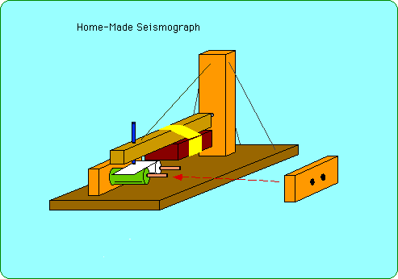
How do Seismographs Work?
A large magnet is used for the blocks and the outside case contains plenty of wire. Movements of the case similar to the magnet generate small electric signals in the wire.
1.http://slohs.slcusd.org
2.http://cse.ssl.berkeley/

Slide 19
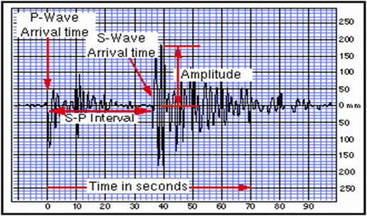
What is a Seismogram?
Now onto Seismograms, they’re often used to mean seismometer but even though it’s more that has to do with seismographs to the older instruments in which the measuring and recording of ground motion were combined than to modern systems, in which these duties are separated.
1.http://en.wikipedia.org
2.http://www.sciencecourseware.org2.http

Slide 20
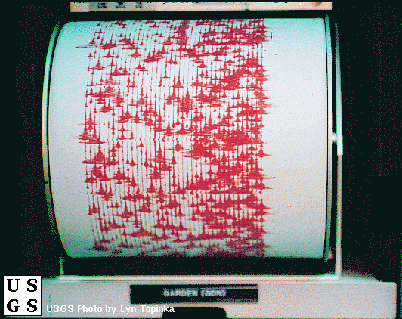
How do Seismograms Work?
When you look at a seismogram, there will be wiggly lines all across it. These are all the seismic waves that the seismograph has recorded. Most of these waves were so small that nobody felt them.
1.http://www.geo.mtu.edu/UPSeis/locating.html
2.http://vulcan.wr.usgs.gov/

Slide 21
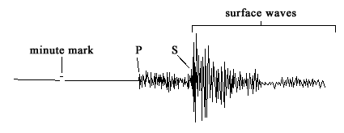
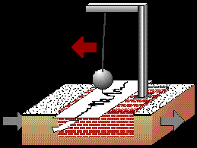
What do Seismograms and Seismographs look like?
Seismogram –
1.http://www.geo.mtu.edu
2.http://www.thetech.org
Seismograph -

Slide 22
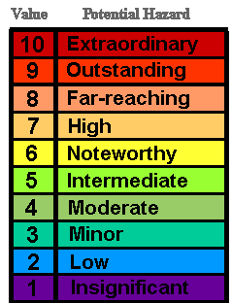
Richter Scale
The Richter Scale refers to a number of ways to assign a single number to measure the energy that holds in the earthquake. All of the time the magnitude is a base-10 logarithmic scale taken by calculating the longarithmic scale. A earthquake measured 5.0 is 10 times larger than a 4.0
1.http://en.wikipedia.org/wiki/Richter_scale
3. BC Science 7 Book
2.http://mishunderstanding.files.wordpress.com/

Slide 23
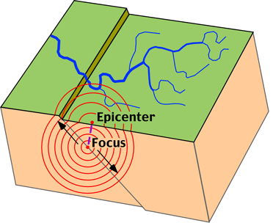
Epicenter
Which is the point on the Earth's surface that is directly above the hypocenter or focus the point where an earthquake or underground explosion starts. If the seismic waves are recorded by at least 3 seismogram the epicenter will be found. Next, in case of earthquakes, the epicenter is directly above the point where the fault begins to break, and in most cases, it’s the area that has the most damage.
1.http://en.wikipedia.org/wiki/Epicenter
3. BC Science 7 Book
2.http://mjksciteachingideas.com/

Slide 24
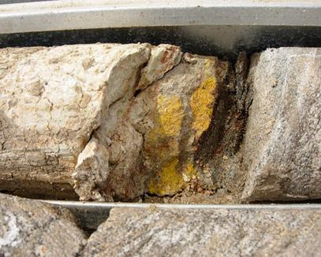
Bedrock
Which is the solid rock underlying loose things such as soil. The seismograph also has to be attached to the bedrock. For example in a news report : “The reason an earthquake in the high 5s is felt so far away is that it could of occured in an area where the bedrock is solid, it’s not really fractured or broken up by faults the way it would be.
1.http://cosmiclog.msnbc.msn.com/
3. BC Science 7 Book
2.http://4b2011.wikispaces.com/

Slide 25
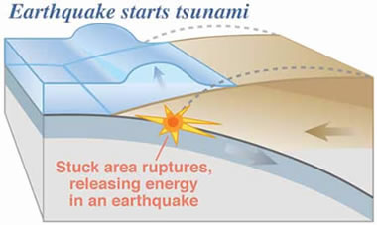
What Causes a Tsunami?
A tsunami is usually caused by a powerful earthquake under the ocean floor. This earthquake pushes plenty of water to the surface, creating waves. These waves are the tsunami.
1.http://www.pep.bc.cat/
2.http://geology.com/

Slide 26
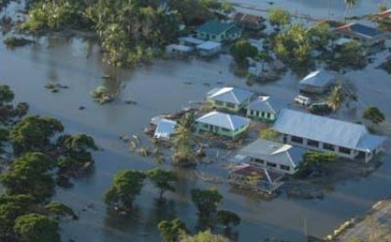
What’s the Results of an Tsunami?
Tsunamis are some of the most devastating natural disasters known to man! Think of a flood with its source being an ocean! I bet you can see a little of how much trouble tsunamis can create.
1.http://www.universetoday.com/
2.http://pacific.scoop.co.nz/

Slide 27
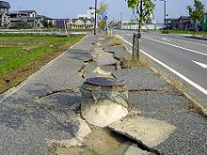
Liquefaction
Lastly, I will be talking to you about is Liquefaction. Which is crazy thin in which the strength and stiffness of a soil is shortened by an earthquake shaking. Liquefaction are related rare, and have been responsible for lots of damage in historical earthquakes around the world.
1.http://www.ce.washington.edu
2.http://upload.wikimedia.org/

