Slide 1
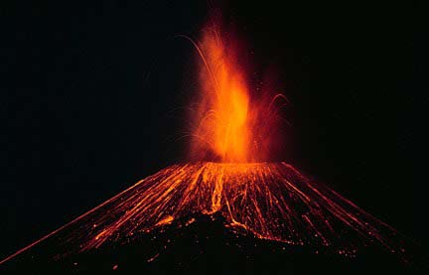
Volcanoes
Katniss Everdeen
Div. 4
Science
A Detailed summary of Volcanoes and
everything about them
2: BC Science 7 Textbook
3: Images: http://www.indianchild.com/images/valcanoe2.jpg
1: DK Eyewitness Book: Volcanoes & Earthquakes
Notes:
DK Eyewitness Book: Volcanoes & Earthquakes

Slide 2
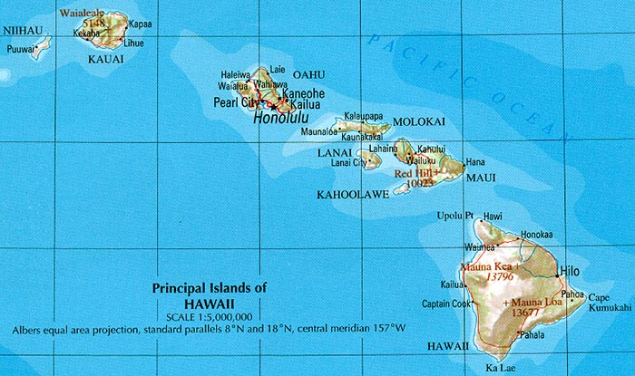
Volcanoes
Volcanoes are a very unique structures that consist of a vent, outer layer, inner layer, sills and dikes. These “structures” sit on the top of the mantle and transport magma out of the earth. Although you probably thought that you could only find volcanoes on land you can also find them underwater! In fact, one of the states of America was formed by several underwater volcanoes! That state is Hawaii.
3: DK Eyewitness Book: Volcanoes & Earthquakes
2: BC Science 7 Textbook
1: Images: http://www.mninter.net/~byerlys/hawaii_ref_map_2001.jpg

Slide 3
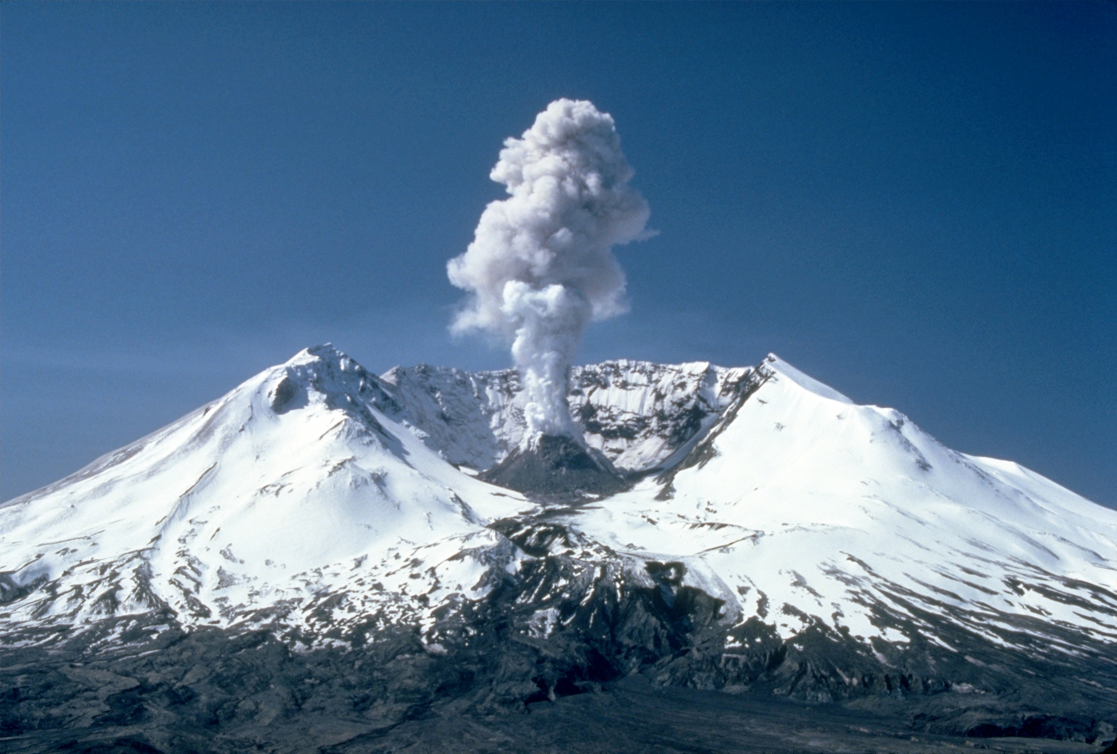
Intrusive Volcanic Features
The intrusive features of the volcano are the most important parts and are needed in a successful volcano that erupts. But, If the intrusive parts of the volcano are flawed or are clogged the volcano will either not erupt or explode into an ashy cloud like Mount St. Helens.
4: DK Eyewitness Book: Volcanoes & Earthquakes
3: BC Science 7 Textbook
2: Summary: http://volcano.oregonstate.edu/how-do-volcanoes-affect-people
1: Image: http://upload.wikimedia.org/wikipedia/commons/d/dc/MSH82_st_helens_plume_from_harrys_ridge_05-19-82.jpg

Slide 4
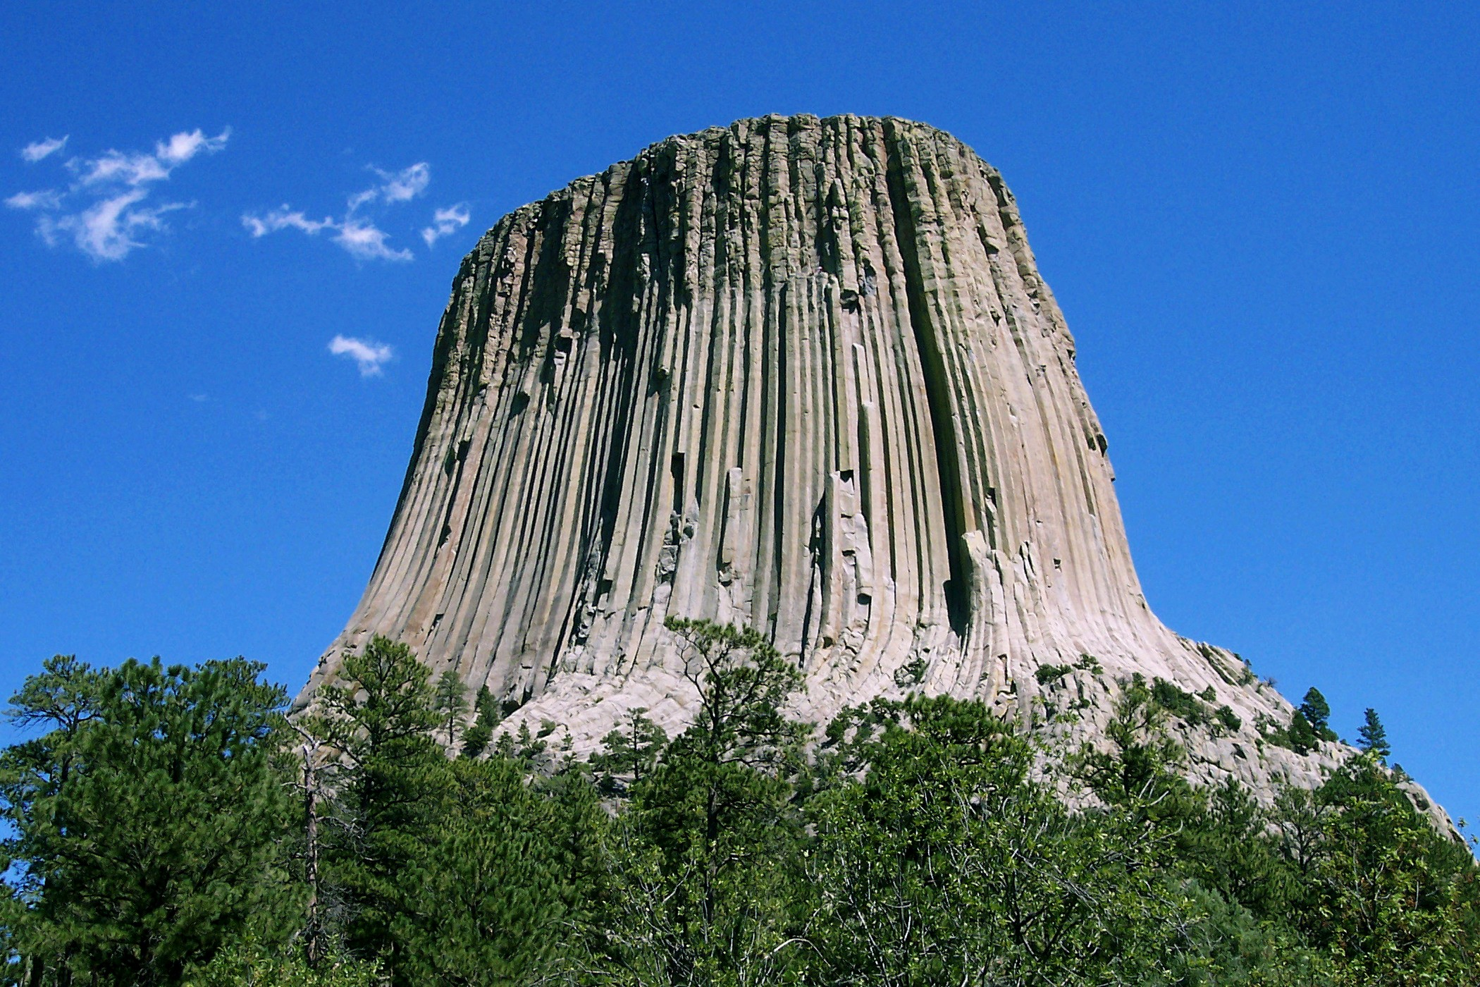
Volcanic Neck
A volcanic neck is a cylindrical rock formation that is formed by the magma that hardens and gets stuck in the vent of the volcano. The only reason you can see it is because the sides of the volcano erodes away from the volcanic neck leaving only the strange rock formation. The reason volcanic necks are not common is because usually when they plug up volcanoes pressure builds and obliterates the “plug” shooting it in the air as ash and bits of rock.
4: DK Eyewitness Book: Volcanoes & Earthquakes
3: BC Science 7 Textbook
2: Summary: http://www.universetoday.com/39717/volcanic-neck/
1: Images: http://upload.wikimedia.org/wikipedia/commons/4/46/Devils_Tower_CROP.jpg
Notes:
Summary:
Multimedia:http://upload.wikimedia.org/wikipedia/commons/4/46/Devils_Tower_CROP.jpg

Slide 5
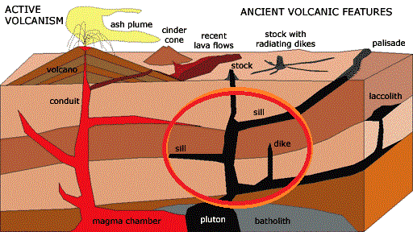
Sills & Dikes
A sill is created when magma flows through already formed rock and hardens parallel to the layers of rock surrounding it but, a dike is formed when magma flows through already formed rock and hardens perpendicular to the layers of rock surrounding it. One of the major differences between the two is the fact that dikes transport magma upward and sills store magma in layers. Both sills and dikes are in the same size range because all they are are big tubes that hold magma and/or transport it.
3: DK Eyewitness Book: Volcanoes & Earthquakes
2: BC Science 7 Textbook
1: Images: http://pubs.usgs.gov/of/2004/1007/images/volcanic.gif

Slide 6
Types of volcanoes
There are three types of volcanoes! The first one is the cinder cone the second is the shield volcano and the third is the composite volcano.
1: Video: http://pubs.usgs.gov/of/2004/1007/images/volcanic.gif
Notes:
Video: http://pubs.usgs.gov/of/2004/1007/images/volcanic.gif

Slide 7
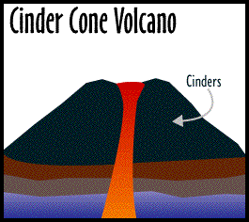
Cinder Cone Volcanoes
Cinder cone volcanoes are hill like structures that are formed when another volcano erupts and the lava hardens to leave the cone shaped hill of rock surrounding the vent of the volcano. These volcanoes are the most common kind and usually have small eruptions. Because of this there are only a couple famous Cinder Cone Volcanoes. The cinder cone volcano’s shape is change throughout its life span and will end up looking very strange in most cases.
4: DK Eyewitness Book: Volcanoes & Earthquakes
3: BC Science 7 Textbook
2: Summary: http://library.thinkquest.org/17457/volcanoes/types.cinder.php
1: Images: http://www.cotf.edu/ete/images/modules/volcanoes/typesa.GIF
Notes:
http://www.cotf.edu/ete/images/modules/volcanoes/typesa.GIF

Slide 8
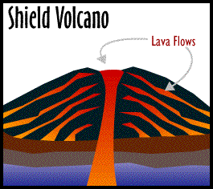
Shield Volcanoes
Almost all shield volcanoes are large in width and not many are small. The way they are formed is that many flows of runny magma spew out of the earth forming a broad sloping cone. The reason this happens is because the basaltic lava is so runny it cannot pile up in big mounds. This odd volcano usually forms under water along the mid ocean ridge or far away from the edges of tectonic plates. These volcanoes are very famous in fact, one of them is the same state of America as before. Hawaii!
3: DK Eyewitness Book: Volcanoes & Earthquakes
2: BC Science 7 Textbook
1: Summary & Images: http://library.thinkquest.org/17457/volcanoes/types.shield.php
Notes:
Large broad
Usually form along mid ocean ridge

Slide 9
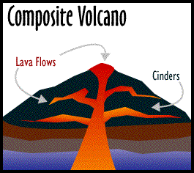
Composite Volcanoes
Composite volcanoes or Strato Volcanoes are very quite and have quick eruptions that only last moments. You would have to be very lucky to see the beginning of a composite volcanoes eruption. These tall volcanoes can be mistaken for mountains because of the snow caps that they get when it starts to snow. The reason for this is that these volcanoes can grow higher than 2500m in height! The way that volcanoes erupt is as if they have a bad cold because their eruptions have an explosive character!
4: BC Science 7 Textbook
3: DK Eyewitness Book: Volcanoes & Earthquakes
2: http://www.cotf.edu/ete/modules/volcanoes/vtypesvolcan1.html
1: http://library.thinkquest.org/17457/volcanoes/types.composite.php
Notes:
Composite volcanoes can grow over 2500m
Erupt=Bad Cough=Explosive Character
Be mistaken for mountains

Slide 10
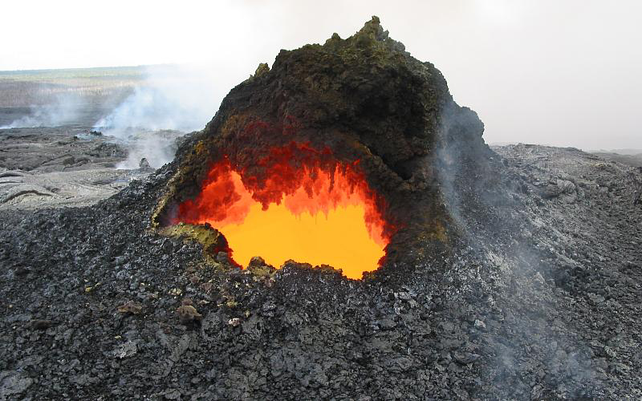
Hot Spots
Hot spots are places in the earth were rocks actually melt to create magma! On these places there are lots of volcanoes that form because of the sufficient supply of magma and other features volcanoes need like a vent. One example of a hot spot is the Hawaiian hot spot that has been creating magma for 70 years. When a hot spot is created below a continental plate lava spews out and covers thousands of square kilometers and this major magma accumulation is called a flood basalt.
3: DK Eyewitness Book: Volcanoes & Earthquakes
2: BC Science 7 Textbook
1: Images: http://www.lbl.gov/Publications/Currents/Archive/images/May-16-2003/20020927-jk-2997_volcano.jpg
Notes:
http://www.lbl.gov/Publications/Currents/Archive/images/May-16-2003/20020927-jk-2997_volcano.jpg

Slide 11
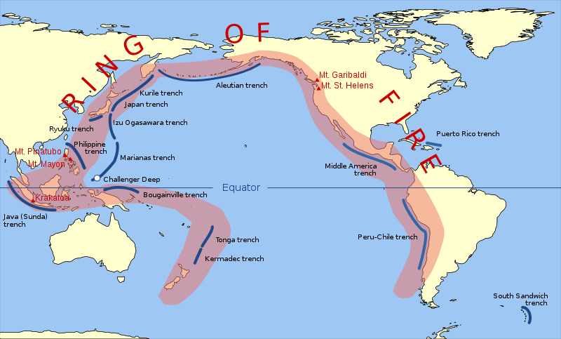
Ring of fire
The ring of fire is a area in the world were volcanoes and earthquakes are most common. The ring of fire contains over 75% of the worlds dormant volcanoes and has over 450 volcanoes in total! The reason the ring of fire is home to so many volcanoes is because the ring of fire is just a whole bunch of tectonic plates pushing against each other creating pressure and volcanoes.
3: DK Eyewitness Book: Volcanoes & Earthquakes
2: BC Science 7 Textbook
1: Summary & Images: http://en.wikipedia.org/wiki/Pacific_Ring_of_Fire
Notes:
http://en.wikipedia.org/wiki/Pacific_Ring_of_Fire

Slide 12
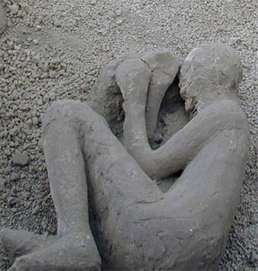
Volcanoes & People
Volcanoes are not always a bad thing to the human race in fact, if you think of it, if volcanoes did not exist we would be living on vary small areas of land and our evolution would struggle.
Pros
They create land masses for us to live on
Brings up resources from the mantle for us to use
And makes for great landscape photos
Cons
Cover farm lands with ash and soot
Covers up towns and cities with molten lava
Destroys man-made structures in the process of erupting
4: DK Eyewitness Book: Volcanoes & Earthquakes
3: BC Science 7 Textbook
2: Image: http://3.bp.blogspot.com/_tefZeAcea7Y/TGJHodvtOII/AAAAAAAAADE/m-I5licHbdE/s400/image002.jpg
1: Summary: http://volcano.oregonstate.edu/how-do-volcanoes-affect-people

Slide 13
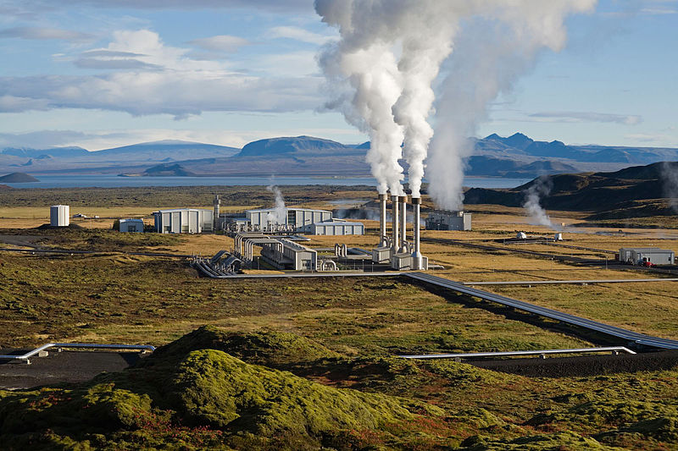
Geothermal Energy
In simple words geothermal energy is the energy that is stored in the core and is carried up by melted rock and then is released as gas. For example the core of the earth can reach a high temperature of 9,000 degrees Fahrenheit so, by the time it reaches the crust the geothermal energy level is now about 500 degrees Fahrenheit and is used for heating, electrical generation, and even bathing!
3: DK Eyewitness Book: Volcanoes & Earthquakes
2: BC Science 7 Textbook
1: Summary & Images: http://en.wikipedia.org/wiki/Geothermal_energy

Slide 14
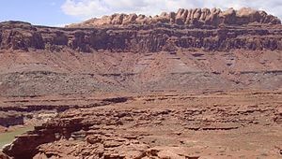
Relative Age
The relative age of a rock or fossil is not the year it was created but merely the sequential order of when that rock and the rocks around it were formed. A scientist named smith soon discovered that only certain animals were in certain layers, and so he started to estimate the time periods these fossils were formed based on the animals themselves. That is now how most scientists estimate the relative age of fossils and rocks although some do have their own crazy methods.
3: DK Eyewitness Book: Volcanoes & Earthquakes
2: BC Science 7 Textbook
1: Summary & Images: http://en.wikipedia.org/wiki/Relative_dating

Slide 15
Thank You
“This now concludes to my PowerPoint as I hope that it has moved you in all ways and especially right off of your chair!”
~ Katniss E.

