Slide 1
Volcanoes
Mickey Mouse

Slide 2
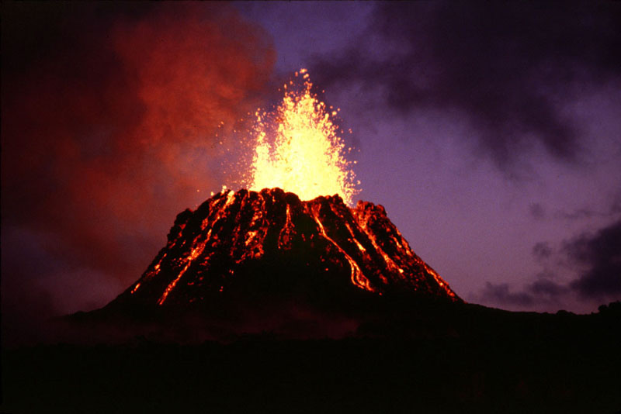
Volcanoes
Volcanoes are mountains where lava erupts from the ground. However, most volcanoes have a crater around the top and when they are active, materials pour out of the volcano. Also, did you know volcanoes are generally found where tectonic plates diverge and converge? Some types of volcanoes are Composite, Cinder Cone and, shield volcanoes . Volcanoes release lava, smoke and ash.
http://simple.wikipedia.org/wiki/volcano
http://dictionary.reference.com/browse/volcano
http://www.essortment.com/volcano-information-61762.html
Text book
http://www.sciencebase.com/science-blog/recent-volcanic-eruptions.html

Slide 3
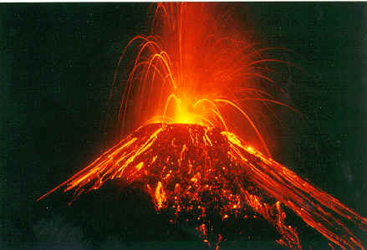
Eruptions
Eruption means when materials of liquid gases explode. Also, whenever the volcano explodes, it is an labeled active volcano. However, when volcanic eruptions happen suddenly, a shatter of the crust begins to break when the magma pressures towards the volcanic vent and then it comes on to the earth’s surface. when the magma comes on to the surface than it is called lava, as well there are lots of types of gases and molten rock that comes out of the volcanic vents.
http://www.trivology.com/articles/1454/what-is-voolcanic-eruption.html
http://www.agrotours.com/mwc/index.htm

Slide 4
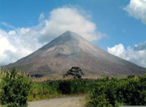
Dormant
Dormant means a volcano that is not active but may become active in the future. However, when volcanoes become dormant the earth’s plates shift above the hot spots. Did you know when the hot spots reach the surface, they create a new volcano? when the tectonic plates continue shifting above the hot spots, eventually the volcano is shut off from the magma chamber. Also, when the volcano becomes older it stops erupting and becomes a dormant volcano.
http://en.wikipedia.org/wiki/dormant
http://www.universetoday.com/28881/dormant-volcanoes/
http://www.internationalcircuit.com/costa-rica/tourism-3.php

Slide 5
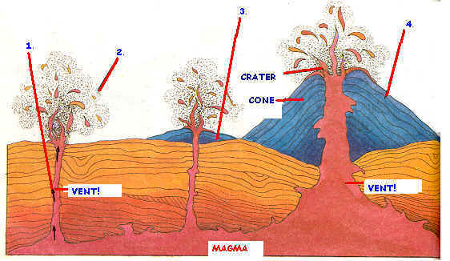
Vents
Vents are openings in earth’s crust which allow molten lava and gases escape on to land. As well, volcanoes have circle vents that are located near the summit crater. Also, when magma makes its way up through the rock, it reaches the earth’s surface and the spot where it erupts is known as a volcanic vent. On the other hand, a vent is a spot in the earth’s crust where gases, molten rock, lava and rocks erupt. However, here’s a hint when the volcano will explode, you you can see the shape of the volcanic vent. Also, sometimes you can tell when the volcano is going to explode or not.
http://www.enotes.com/volcanic-vent-reference/volcanic-vent
http://www.ict.mic.ul.ie/websites/2002/Karen_Morrissey/karens%20volcano%20formation.htm

Slide 6
Types of Volcanoes
There are 3 types of volcanoes which are composite volcano, Cinder Cone volcano and shield volcano.
Text book

Slide 7
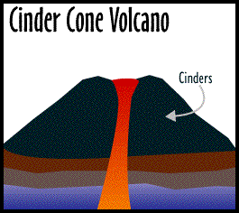
Cinder Cone Volcano
Did you know that the most common volcano is the cinder cone volcano? Also, the gases that carry liquid lava blobs go into the atmosphere and then falls into the earth around a single vent to form the cone. On the other hand, if you were wondering what a cinder is it is a melted volcanic rock that is cooled and formed in small sizes after it was thrown in the air. Also, cinder cones can occur alone or in small to large groups or fields. However, the longer the eruption is, the higher the cone will be.
http://www.k12.hi.us/kapunaha/student_projects/volcblowout/cinder_cone_volcano.htm
http://www.k12.hi.us/kapunaha/student_projects/volcblowout/cinder_cone_volcano.htm

Slide 8
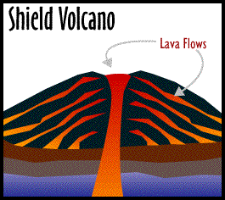
Shield Volcano
Shield volcanoes are very large volcanoes that are built mostly with lava. Also, shield volcanoes have sloping sides and usually surrounded by gently sloping hills in a circle fan shape pattern. The volcano is made by the action of the gas, steam and water and the heat from the earth’s core. The heat from the pressures pushes the magma upwards until it explodes. As well, the lava is very watery and cannot be piled up onto steep hills. Again, the shield volcanoes are one of the largest volcanoes in the world.
http://www.k12.hi.us/kapunaha/student_projects/volcblowout/cinder_cone_volcano.htm
Text book
http://www.k12.hi.us/kapunaha/student_projects/volcblowout/cinder_cone_volcano.htm

Slide 9
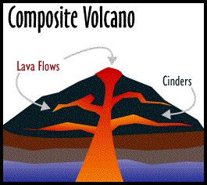
Composite Volcanoes
Composite volcanoes have a vent and come where lava flows. When composite volcanoes form they form when watery lava escapes. Did you know, that composite volcanoes are tall cone shaped mountains? On the other hand, composite volcanoes erupt in different ways and at different times. Some composite volcanoes have a crater, which contains a central vent. Also, the lava flows through breaks in the crater walls
http://www.k12.hi.us/kapunaha/student_projects/volcblowout/cinder_cone_volcano.html
http://library.thinkquest.org/28327/html/universe/solar_system/planets/earth/surface/composite_volcano.html
http://www.k12.hi.us/kapunaha/student_projects/volcblowout/cinder_cone_volcano.htm

Slide 10
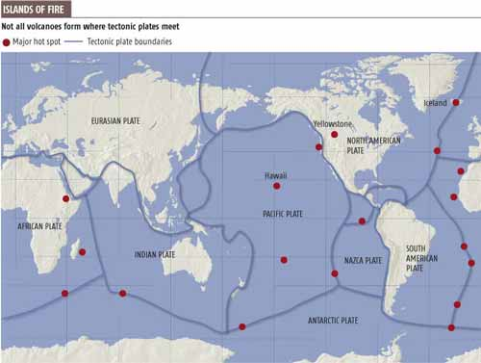
Hot Spots
Hot spots are hot materials that rise from the core of the mantle boundary. Also, the hot spot causes melting. For this reason, because the tectonic plates move across from each other, the volcano becomes dormant after a while and then a new volcano is formed as the plates shift. Also, a hot spot is a volcanic area that is hot compared to other places in the volcano.
http://en.wikipedia.org/wiki/volcanoes
Red spots = major hot spots.
http://www.mantleplumes.org/VolcanicBombs.html

Slide 11
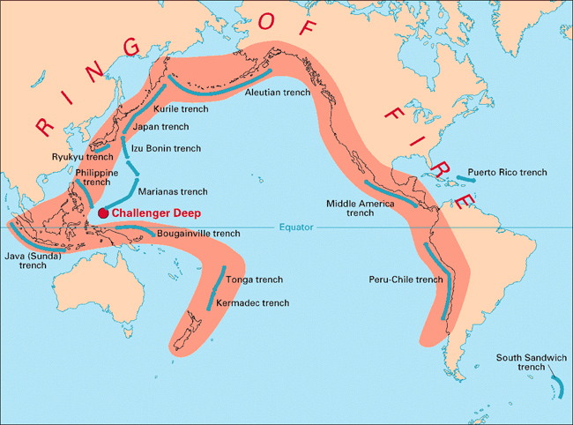
Ring of Fire
The Ring of fire is an area where very large earthquakes and volcanic eruptions occur. Also the ring of fire is an area of the earth in which circles around the pacific ocean. Did you know, that the ring of fire is eighty percent located with volcanoes also eighty one percent if all the volcanoes causes the largest earthquakes
http;//en.wikipedia.org/wiki/pacific _ring-of-fire
http;//en.wikipedia.org/wiki/pacific _ring-of-fire

Slide 12
Why do people live near Volcanoes?
I think it would be scary and dangerous to live near volcanoes. But after all, the volcanoes have very bad explosions with liquid rock, ash, poisonous gasses and red hot clouds and usually killing people. But it’s true that people are risking their lives to live very close to volcanoes. People say that they chosen to live their because they think it is perfectly safe to live near volcanoes because they think on long periods of times when it erupts, those that do erupt possibly are thought of the people who live there as, being the people that knew what happened.
http://www.geography

Slide 13
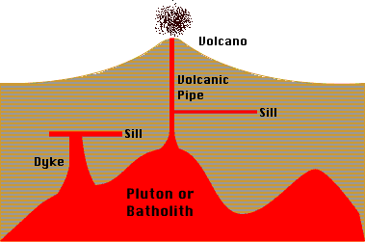
Intrusive Volcanic Features
Intrusive volcanic features are landforms from the cooling and crystallization of magmas beneath the surface, by the erosion of rock. As a result, intrusive landforms on the earth’s surface. Also, the secret of intrusive landforms is based on landform size and shape.
Site.co.uk/pages/physical/earth/volcanoes/volcanoliving.html
http://www.physicalgeography.net/fundamentals/10j.html

Slide 14
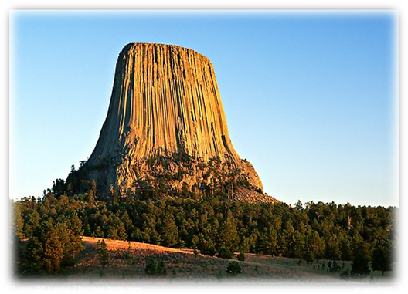
Volcanic Neck
A Volcanic Neck is like a top of a tooth paste bottle but is made out of solid rock. As well, volcanic necks are very rare and when it plugs, the volcano it is often an eruption. Then, the plug is broken up into ash and rock in a second. However, if the pressure isn’t hard enough than the plug cools and hardens deep into the earth. A cool fact about the volcanic neck is that the type of erosion that happens will define the shape of the volcanic neck.
http://en.wikipedia.org/wiki/volocanicneck_geology
http://www.terragalleria.com/america/wyoming/devils-tower/picture.uswy8387.html

Slide 15
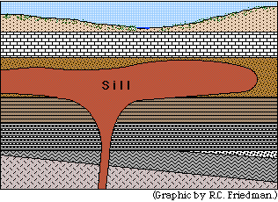
Sill
Sills are always side by side to bed layers of surrounding rock. Usually they are up and down although tectonic plates can cause rotation of sills and also they can be confused by lava. However, there are several differences between them. Did you know, that lava will show weathering on their upper surface where sills are still covered by country rock.
http://en.wikipedia.org/wiki/sill_geology
http://www.psrd.hawaii.edu/Dec96/Nakhlites.html
Sills are always side by side to bed layers of surrounding rock. Usually they are up and down although tectonic plates can cause rotation of sills and also they can be confused by lava. However, there are several differences between them. Did you know, that lava will show weathering on their upper surface where sills are still covered by country rock.
Sills are always side by side to bed layers of surrounding rock. Usually they are up and down although tectonic plates can cause rotation of sills and also they can be confused by lava. However, there are several differences between them. Did you know, that lava will show weathering on their upper surface where sills are still covered by country rock.
Sills are always side by side to bed layers of surrounding rock. Usually they are up and down although tectonic plates can cause rotation of sills and also they can be confused by lava. However, there are several differences between them. Did you know, that lava will show weathering on their upper surface where sills are still covered by country rock.
Sills are always side by side to bed layers of surrounding rock. Usually they are up and down although tectonic plates can cause rotation of sills and also they can be confused by lava. However, there are several differences between them. Did you know, that lava will show weathering on their upper surface where sills are still covered by country rock.
Sills are always side by side to bed layers of surrounding rock. Usually they are up and down although tectonic plates can cause rotation of sills and also they can be confused by lava. However, there are several differences between them. Did you know, that lava will show weathering on their upper surface where sills are still covered by country rock.
Sills are always side by side to bed layers of surrounding rock. Usually they are up and down although tectonic plates can cause rotation of sills and also they can be confused by lava. However, there are several differences between them. Did you know, that lava will show weathering on their upper surface where sills are still covered by country rock.
Sills are always side by side to bed layers of surrounding rock. Usually they are up and down although tectonic plates can cause rotation of sills and also they can be confused by lava. However, there are several differences between them. Did you know, that lava will show weathering on their upper surface where sills are still covered by country rock.

Slide 16
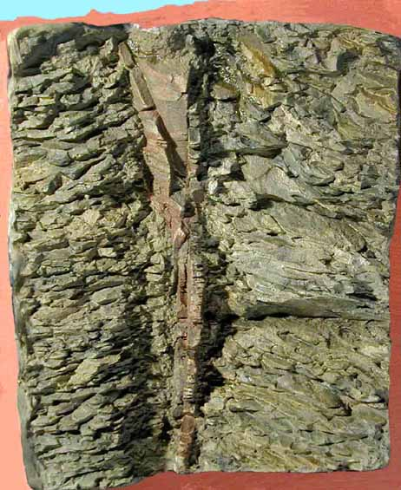
Dike
A dike is an opening layer or bodies of rock. Also, dikes are sheets of magma that cut through the layering of rocks. In addition to this, dikes form when magma rises and then it fractures. Then this forms a new crack by pushing its way through the rock and then it becomes solid. Also, hundreds of dikes can break the cone and inner core of a volcano sometimes even making it weaker.
http://en.wikipedia.org/wiki/dike_geology
http://www.cripplebush.net/pages/dike1.htm

Slide 17
Energy from inside the Earth
There is another kind of energy and it is called geothermal energy and geothermal energy is to heat people’s houses and to make electricity, by digging deep wells and pumping the heated underground water or steam to the surface.
http://www.geography4kids.com/files/en_intro.html

Slide 18
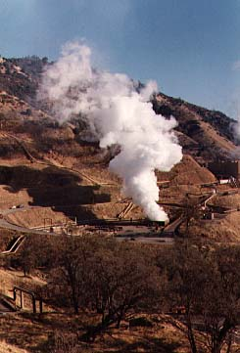
Geothermal Energy
Geothermal energy is heat from within the earth. We can use that steam and hot water to make the inside of the earth to heat buildings or make electricity. Geothermal energy is an ongoing energy source because the water is refilled by rainfalls and the heat is making inside the earth. On the other hand, steam is not used directly because it contains so many minerals that it could clog pipes and poison the water materials. Also, the heat from underground steam is used to make electricity or to heat water materials and they are used to make houses warm and so we can have hot water to use.
http://www.edinformaticts.com/math_science/alternitive_energy/geothermal/geothermal_enrgy_basics.htm
http://www.daviddarling.info/encyclopedia/G/AE_geothermal_energy.html

Slide 19
The Relative age of Rocks
The first person to study on the age of rocks was James Hutton. There are two kinds of relative ages of rocks which are:
The principal of superposition and relative age.
Also, to find out whether a material is younger or older in other surrounding material on the objects.
http://www.ehow.com/how_6538444_relative-age-rocks.html
http://www.geology.ar.gov/pdf/relative%20age%20dating.pdf

Slide 20
The principal of superposition
The principal of superposition may be applied to waves because whenever two or more waves travel through the same time. Then they have to pass through each other without being bugged. Also, when two waves are exactly the same, they travel in the same direction on a string.
http://thefreedictionary.com/principal+of+superstition

Slide 21
Relative age
How to find the age of the rock is when you look at any fossils the rock may contain. However, another hint to see the relative age is ‘’what’s on the top rule’’ which is you can find the layers of rocks in a cliff or a hillside and the younger rocks are on the top which means the older rocks are on the bottom. But these two hints of how to find the relative age are only given which ones the younger rock and which ones the older rock. On the other hand, the ages of the rock of years is called the Absolute age.
http://wikipedia.com

Slide 22
Absolute age
The absolute age is the numbers of ages of rocks, events, or objects. Also, the absolute age of fossils is knowing the ages of the other kinds of rocks. On the other hand, the absolute age is the measurement of ages in years. To find out the actual age of rocks, minerals and fossils is in years before to day.
http://edhelper.com/readingcomprehension_37_84.html

Slide 23
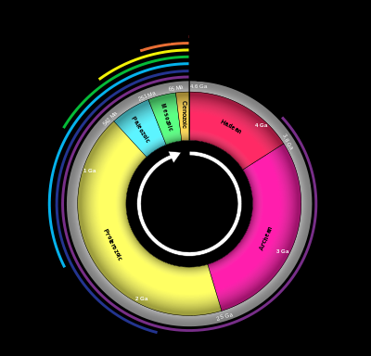
Geological time scale
The geological time scale provides a system called chronologic measurement relating to time that is used. However, the geological time scale uses standard color codes of the united states of geological survey. Also a cool fact is that the first person that needed to understand geological time scale was the miners
http://en.wikipedia.org/wiki/geologic_time_scale
http://en.wikipedia.org/wiki/Geological_time_scale

Slide 24
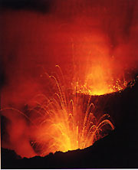
Why do volcanoes erupt?
Volcanoes exist at weak points in the earth’s crust. On the other hand, active volcanoes act like giant plugs that hold back molten rock. Under this plug, pressure builds up until eventually the volcano explodes.
Library book
http://www.michaelmcfadyenscuba.info/viewpage.php?page_id=40

Slide 25
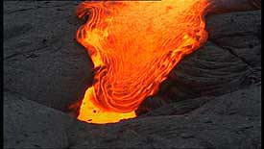
Why does lava flow?
Lava is rock that is so hot it melts. Than it blast out of volcanoes when they erupt, burning a orange river of fire. As soon as lava cools down it hardens, forming dozens of different types of rocks.
Library book
http://www.abc.net.au/wa/tv/earth.htm

